Slide 1



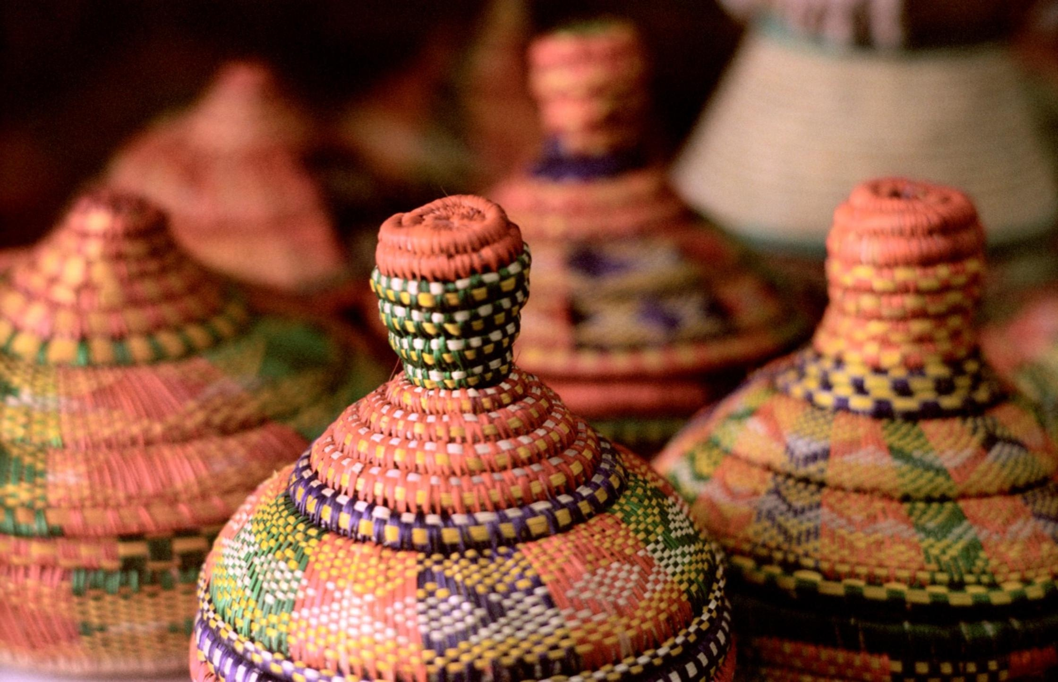





Africa Impact Academy
THEORY OF CHANGE TEMPLATE

Slide 2
What Is a Theory of Change?
A Theory of Change (ToC) is a clear, logical framework that explains how and why a desired change is expected to happen in a particular context. It maps the journey from inputs and activities to outputs, outcomes, and long-term impact.
Why Is It Important for Entrepreneurs?
  Clarifies strategic direction by connecting day-to-day activities with long-term goals.
  Guides program design and resource allocation more effectively.
  Supports fundraising by demonstrating logic and potential for impact to donors or investors.
  Strengthens monitoring and evaluation, helping track what’s working and what’s not.
  Enables stakeholder alignment, keeping your team, partners, and beneficiaries on the same page.

Slide 3
Theory of Change Template Questions
Use these sections and questions to develop your ToC:
1. Define the Problem
What specific problem(s) are you trying to solve? What issue does your business or project seek to address? Who is affected by this problem? What are the root causes of this problem?
Uhai Life Sciences strengthens the blood supply chain pillars of Access, Processing, and distribution.
It ensures that patients in critical need of blood transfusions receive adequate quantities promptly.
This is because Kenya suffers from inadequate access and variable distribution of blood for patients suffering from chronic and acute critical diseases.
Insufficient quantities of blood received by the blood bank creates bias in distribution to patients.
Inadequate access to blood prolongs hospitalization and increases the cost of patient care.

Slide 4
2. Define Your Desired Impact
What long-term change do you want to see as a result of your work? In an ideal future, what will have changed in the lives of your target audience or community? How will your solution contribute to societal, environmental, or economic improvement?
By strengthening the blood supply chain according to the World Health Organisation’s Health Systems Strengthening Pillars. We focus on the Health Products and Technologies Pillar.
Through this pillar we hope to ensure we have:
  Adequate donations during blood drives.
  A recurrent pool of donors built.
  Knowledge of available quantities for better planning.
  Sustainable and adequate quantities of blood and blood products for transfusion.
  Reduced human interference and bias in the blood product consumption supply chain.

Slide 5
3. Identify Your Target Group(s)
Who are the primary beneficiaries of your intervention? Who will benefit directly and indirectly from your product or service? What are their needs, contexts, and barriers to change?
Patients in need of transfusion (Blood Disorders, Cancer, Trauma, undergoing surgery)
  Reduced dependence on replacement donations prior to transfusion.
  Adequate and safe quantities of transfused blood.
  Reduced transfusion costs and bias in blood distribution.
  More saved lives through targeted and ringfenced blood.
Blood Donors
  Increased donor awareness
  Positive reinforcement of blood donors through non-monetary rewards (digital medals).
  Transforming blood drives into more of social events (‘street bashes, dance competition’)
Volunteers (healthcare workers, students, entertainers).
  More knowledgeable and altruistic volunteers who make blood drives sustainable.

Slide 6
4. List Your Inputs (Resources)
What resources do you need to implement your activities? Financial, human, technological, and material resources. Partnerships or stakeholder involvement
People – Healthcare workers, Volunteers (mobilizers), Blood Donors.
Technology – Predictive Models, Behavioural reward systems, Computers, Internet, Databases.
Financing – Grants, Accelerators, Hubs, Equity.
Partnerships/ Stakeholders:
  The national and County governments
  Kenya Tissue and Transplant Services (Blood Banks)
  Hospitals (public and private) – MTRH, private hospitals in Eldoret
  Training institutions (colleges and universities)
  Research Institutions – AMPATH, Innovative Hematology
  Professional Organizations – Oncology Nurses Chapter
  Business Community –Bakeries, Beverage and Event companies.

Slide 7
5. Outline Your Activities
What specific actions will you take to address the problem? What are the key programs, services, or operations you will carry out? How are these activities linked to your goals?
ACCESS:
  Predictive modeling for blood volumes donated.
  Sending targeted messages to previous blood donors on upcoming blood drives.
  Creating a behavioral reward system using digital medals.
PROCESSING:
  Linking the Uhai portal to a temperature monitoring system to assess temperature fluctuation during long-term storage and transportation.
DISTRIBUTION: Creating a consolidated database of available quantities of blood.

Slide 8
6. Describe Your Outputs
What are the immediate, tangible results of your activities?What will be produced or delivered (e.g., workshops held, products distributed, clients served)? How will you measure them?
ACCESS:
  Predictive model for blood donation drives.
  Targeted messages sent and feedback.
  Recurrent blood donors.
PROCESSING:
  Reduced temperature fluctuation of blood refrigerators.
DISTRIBUTION: Standard inventory of blood products.

Slide 9
7. Define Your Outcomes
What short- to medium-term changes do you expect to see? How will behavior, skills, or conditions change for your beneficiaries? What are realistic and measurable changes expected within 1–3 years?
ACCESS:
  Adequate donations during blood drives.
  A recurrent pool of donors built.
  Sustainable and adequate quantities of blood.
PROCESSING: Stability of blood and blood products.
DISTRIBUTION:
Knowledge of available quantities for better planning.
Reduced human interference and bias in the blood product consumption supply chain.

Slide 10
8. Map the Assumptions
What conditions must hold true for your ToC to succeed? What assumptions are you making about how change happens? Are there external factors or risks that could affect your outcomes?
Interest in voluntary blood donations.
Stakeholder buy-in.
Regular stability on digital technologies.

Slide 11
9. Define Indicators of Success
How will you know if you're making progress? What will you measure at each stage (outputs, outcomes, impact)? What data sources will you use?
Our success is measured by key indicators: 30% increase in recurring blood donors and a 20% reduction in blood wastage. Our platform's predictive algorithms ensure that blood is delivered to the right patients at the right time, based on real-time demand.
ACCESS:
  A working Predictive Model algorithm.
  Number of target blood drive sites.
  Number of recurrent donors.
PROCESSING: Temperature monitoring.
DISTRIBUTION: Blood products catalogue and inventory; Number of requests for patient transfusions.

Slide 12
Final Theory of Change
Inputs
Activities
Outputs
Outcome
Impact
  People
  Funding
  Technologies
  Partnerships and Stakeholders.
ACCESS:
  Predictive modeling for blood volumes donated.
  Sending targeted messages to previous blood donors on upcoming blood drives.
  Creating a behavioral reward system using digital medals.
PROCESSING
  Linking the Uhai portal to a temperature monitoring system to assess temperature fluctuation during long-term storage and transportation.
  DISTRIBUTION
  Create a consolidated database of available quantities of blood.
ACCESS:
  Predictive model for blood donation drives.
  Targeted messages sent and feedback.
  Recurrent blood donors.
PROCESSING:
  Reduced temperature fluctuation of blood refrigerators.
DISTRIBUTION: Standard inventory of blood products.
ACCESS:
  Adequate donations during blood drives.
  A recurrent pool of donors built.
  Sustainable and adequate quantities of blood.
PROCESSING: Stability of blood and blood products.
DISTRIBUTION:
Knowledge of available quantities for better planning.
Reduced human interference and bias in the blood product consumption supply chain.
  Reduction in blood shortages.
  Sufficient number of safe blood units for transfusion.
  Increased number of lives saved.
  Reduced Hospital Stay

Slide 13
Final Theory of Change

Slide 14


Thank You!

